Slide 1
Lecture 11: Java Generics: Weaving the Universal into the Fabric of the Particular

Slide 2
Wholeness Statement
Java generics facilitate stronger type-checking, making it possible to catch potential casting errors at compile time (rather than at runtime), and in many cases eliminate the need for downcasting. Generics also make it possible to support the most general possible API for methods that can be generalized. We see this in simple methods like max and sort, and also in the new Stream methods like filter and map. Generics involve type variables that can stand for any possible type; in this sense they embody a universal quality. Yet, it is by virtue of this universal quality that we are able to specify particular types (instead of using a raw List, we can use List<T>, which allows us to specify a list of Strings – List<String> -- rather than a list of Objects, as we have to do with the raw List). This shows how the lively presence of the universal sharpens and enhances the particulars of individual expressions. Likewise, contact with the universal level of intelligence sharpens and enhances individual traits.

Slide 3
Lesson Outline
Introduction to generics
Generic methods
Wildcards
Understanding Common Generic Signatures
Generic programming with generics

Slide 4
Introducing Generic Parameters
Prior to jdk 1.5, a collection of any type consisted of a collection of Objects, and downcasting was required to retrieve elements of the correct type.
List words = new ArrayList(); words.add("Hello"); words.add(" world!"); String s = ((String)words.get(0)) + ((String)words.get(1)); System.out.print(s); //output: Hello world!
In jdk 1.5, generic parameters were added to the declaration of collection classes, so that the above code could be rewritten as follows:
List<String> words = new ArrayList<String>(); words.add("Hello"); words.add(" world!"); String s = words.get(0) + words.get(1); System.out.print(s); //output: Hello world!

Slide 5
Benefits of Generics
Stronger type checks at compile time. A Java compiler applies strong type checking to generic code and issues errors if the code violates type safety. Detecting errors at compile time is always preferable to discovering them at runtime (especially since, otherwise, the problem might not show up until the software has been released).
Example of poor type-checking
List myList = new myList(); myList.add("Tom"); myList.add("Bob"); . . . // no compiler check to prevent this
Employee tom = (Employee)myList.get(0);

Slide 6
Reduced Downcasting. Downcasting is considered an “anti-pattern” in OO programming. Typically, downcasting should not be necessary (though there are plenty of exceptions to this rule); finding the right subtype should be accomplished with late binding.
Example of bad downcasting
//Populate with Triangles and Rectangles
ClosedCurve[] closedCurves = . . . if(closedCurves[0] instanceOf Triangle) { print((Triangle)closedCurve[0].area()); }
else {
print((Rectangle)closedCurve[0].area()); }

Slide 7
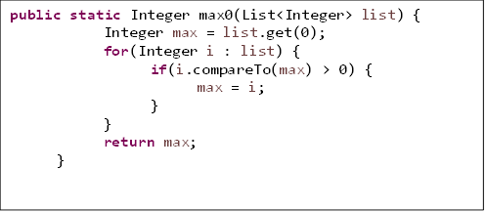
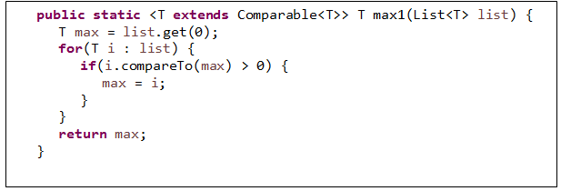
Supports the most general possible API for methods that can be generalized .
Example Task: get the max element in a list (difficult to do without generics)

Slide 8
Generics Terminology and Naming Conventions
In the following code:
List<String> words = new ArrayList<String>(); words.add("Hello"); words.add(" world!"); String s = words.get(0) + words.get(1); System.out.print(s); //output: Hello world!
the class (found in the Java libraries) with declaration
class ArrayList<T> { . . . }
is called a generic class, and T is called a type variable or type parameter.

Slide 9
The delcaration
List<String> words; //read:"List of String"
is called a generic type invocation, String is (in this context) a type argument, and List<String> is called a parametrized type. Also, the class List, with the type argument removed, is called a raw type.
Note the difference between generic class and parameterized type, and between type variable and type argument
Note: When raw types are used where a parametrized type is expected, the compiler issues a warning because the compile-time checks that can usually be done with parametrized types cannot be done with a raw type.

Slide 10
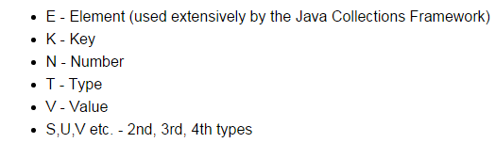
Commonly used type variables:

Slide 11
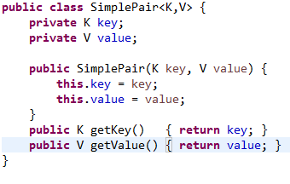
Creating Your Own Generic Class or Interface
Notes:
The class declaration introduces type variables K, V. These can then be used in the body of the class as types of variables and method arguments and return types. The same principle applies when defining a generic interface.
The type variables may be realized as any Java object type (even user-defined), but not as a primitive type.
Usage Example:
SimplePair<Integer,String> pair
= new SimplePair<>(10123, "Jim"); String employeeId = pair.getKey(); //returns Jim's ID

Slide 12

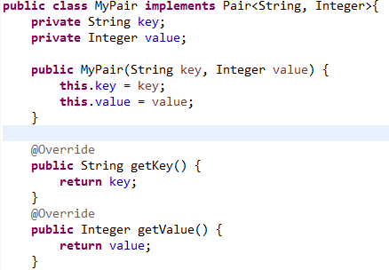
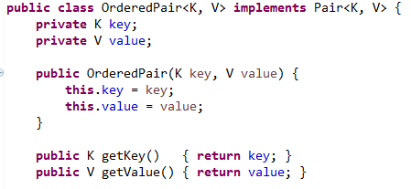
Implementing a Generic Interface
One way: Create a parametrized type implementation
Another way: Create a generic class implementation
See Demo: lesson10.lecture.generics.pairexamples
Notes:
The same points apply for extending a generic class:
Class MyList<T> extends List<T>{}
Or
Class MyList extends ArrayList<String>{}

Slide 13
Extending a Generic Class
The same points apply for extending a generic class.
Either: Create a generic subclass
public class MyList<T> extends ArrayList<T>{
…
}
Or: Create a parametrized type subclass
public class MyList extends ArrayList<String>{
…
}

Slide 14
How Java Implements Generics: Type Erasure
The compiler transforms the following generic code
List<String> words = new ArrayList<String>(); words.add("Hello"); words.add(" world!"); String s = words.get(0) + words.get(1); System.out.print(s); //output: Hello world!
into the following non-generic code:
List words = new ArrayList(); words.add("Hello"); words.add(" world!"); String s = ((String)words.get(0)) + ((String)words.get(1)); System.out.print(s); //output: Hello world!

Slide 15
How Java Implements Generics: Type Erasure (cont.)
Java is said to implement generics by erasure because the parametrized types like List<String>, List<Integer> and List<List<Integer>> are all represented at runtime by the single type List.
Also erasure is the process of converting the first piece of code to the second.
The compiled code for generics will carry out the same downcasting as was required in pre-generics Java.

Slide 16
How Java Implements Generics: Type Erasure (cont.)
Benefits of this implementation approach:
No increase in the number of types in the language (in C++, each parametrized type is a genuinely different type)
Backwards compatibilty with non-generic code – for instance, in both generic and non-generic code, there is, at runtime, only one type List, so legacy code and generic code can intermingle without much difficulty.

Slide 17
Ways That Java’s Implementation of Generics Is Unintuitive
Generic Subtyping Is Not Covariant.
Manager is a subclass of Employee
BUT
ArrayList<Manager> is NOT a subclass of ArrayList<Employee>
Array Subtyping Is Covariant
Manager is a subclass of Employee
AND
Manager[] is a subclass of Employee[]
Notes:
Optional: (Requires strong mathematical background) The real meaning of “covariant”. A mathematical category is a collection of objects of the same type together with structure-preserving maps that map one object in the category to another. The category of sets has as its objects sets together with functions from one set to another. The collection Class of all classes (say Java classes) also forms a category; in this case, the “maps” between objects of this category are the arrows given by the subclass relation. Another category ClassArray is the collection of arrays having component type a Java class, like Employee[], Manager[], etc. Again the “maps” between these objects can be taken to be the subclass relation. The statement “array subtyping is covariant” means, technically speaking, that the transformation F: Class -> ClassArr defined by F(C) = C[ ] is functorial: If C is a subclass of D, then F(C) is a subclass of F(D). The transformation G: Class -> ParamList, given by G(C) = List<C> is not functorial according to the rules of Java generics.

Slide 18
Exercise 11.1
This exercise illustrates one reason why generic subtyping is not allowed to be covariant. Examine the following code and answer the following:
In what step is the coder attempting to use covariance?
Assuming the Java designers had decided to permit covariant generic subtyping, what happens in the code that is undesirable – and should not be allowed? (Hint: What is contained in the ints list at the end?)
List<Integer> ints = new ArrayList<Integer>();
ints.add(1);
ints.add(2); List<Number> nums = ints;
nums.add(3.14);
System.out.print(ints);

Slide 19
Solution to Exercise 11.1
List<Integer> ints = new ArrayList<Integer>();
ints.add(1);
ints.add(2);
//assuming covariance, this step would be allowed
List<Number> nums = ints;
nums.add(3.14);
System.out.print(ints); //output: [1, 2, 3.14] – not desirable

Slide 20
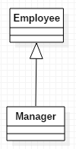
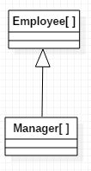

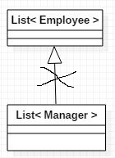
Ways That Java’s Implementation of Generics Is Unintuitive
not
covariant
covariant

Slide 21
Optional: The Origin of the Term "Covariant"
Optional: (Requires strong mathematical background) The real meaning of “covariant”. A mathematical category is a collection of objects of the same type together with "structure-preserving" maps that map one object in the category to another. The category of sets has as its objects sets together with functions from one set to another.
The collection class of all Java classes also forms a category; in this case, the “maps” between objects of this category are the arrows given by the subclass relation. Another category class_array is the collection of arrays having component type a Java class, like Employee[], Manager[], etc. Again the “maps” between these objects can be taken to be the subclass relation.
Another category is param_list – the collection of all parametrized lists. The statement “array subtyping is covariant” means, technically speaking, that the transformation F: class-> class_array defined by F(C) = C[ ] is functorial: If C is a subclass of D, then F(C) is a subclass of F(D). The transformation G: class-> param_list , given by G(C) = List<C> is not functorial according to the rules of Java generics.

Slide 22
Ways That Java’s Implementation of Generics Is Unintuitive (cont)
Component type of an array is not allowed to be a type variable. For example, we cannot create an array like this (the compiler has no information about what type of object to create) T[] arr = null; //this is ok so far arr = new T[5]; //this produces a compiler error
Example: [This issue arises in Java's Collection classes]
class AbstractCollectionFirstTry {
public static <T> T[] toArray(Collection<T> coll) {
T[] arr = new T[coll.size()]; //compiler error
int k = 0; for(T element : coll) arr[k++] = element; return arr; } }
See demo: lesson11.lecture.generics.toarray

Slide 23
Ways That Java’s Implementation of Generics Is Unintuitive (cont)
Component type of an array is not allowed to be a parametrized type. For example: you cannot create an array like this:
List<String>[] = new List<String>[5];
Example:
class Another {
public static List<Integer>[] twoLists() {
List<Integer> list1 = Arrays.asList(1, 2, 3);
List<Integer> list2 = Arrays.asList(4, 5, 6);
//compiler error
return new List<Integer>[] {list1, list2}; } }
Notes:
[Optional] Reifiable Types
The reason for rules (2) and (3) is that the component type of an array must be a reifiable type.
Precise definition: A type is reifiable if the type is completely represented at run time
— that is, if erasure does not remove any useful information.

Slide 24
Ways That Java’s Implementation of Generics Is Unintuitive (cont)
Reifiable Types
The reason for rule (3) (previous slide) is that the component type of an array must be a reifiable type.
Consider the analogous situation with arrays: The following statement
new String[size]
allocates an array, and stores in that array an indication that its components are of type String. However, executing new ArrayList<String>()
allocates a list, but does not store in the list any indication of the type of its elements.We say that Java reifies array component types but does not reify list element types (or other generic types). In the case of
new List<Integer>[] //not allowed because the List type does not store component type information, the resulting array is unable to store component type information (which violates rules for arrays). We say parametrized types (as well as type variables) are not reifiable.
Precise definition: A type is reifiable if the type is completely represented at run time — that is, if erasure does not remove any useful information.
Notes:
[Optional] Reifiable Types
The reason for rules (2) and (3) is that the component type of an array must be a reifiable type.
Precise definition: A type is reifiable if the type is completely represented at run time
— that is, if erasure does not remove any useful information.

Slide 25
Lesson Outline
Introduction to generics
Generic methods
Wildcards
Understanding Common Generic Signatures
Generic programming with generics

Slide 26

Generic Methods
Generic methods are methods that introduce their own type parameters. This is similar to declaring a generic type, but the type parameter's scope is limited to the method where it is declared. Static and non-static generic methods are allowed, as well as generic class constructors.

Slide 27


Calling a Generic Method
Earlier versions of Java required that you specify the generic type arguments when calling a generic method (see below), but current versions are always able to infer types, so the type arguments can be left out.
The complete syntax for invoking this method would be:
The generic type(s) can always be inferred by the compiler, and can be left out.

Slide 28
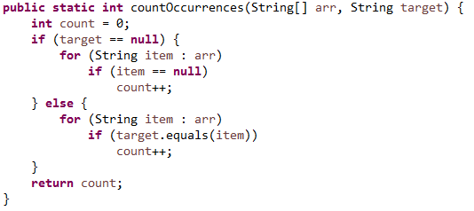
Using Generic Methods to Generalize Behavior
The following code counts occurrences of a target String inside a given input array.
But the same procedure could be used to find a target of any given type in an array of the same type. Generic methods allow us to generalize from type String to an arbitrary type T.

Slide 29
Exercise 11.2
The code for countOccurrences is in the package lesson11.exercise_2 in the InClassExercises project.
Do the following:
Turn the method into a generic method so that it can be used to count occurrences of an object of any type in an array whose components are of the same type.
Then try writing the code for your generic method using a Stream pipeline instead of imperative code

Slide 30
Main Point 1
Generic methods make it possible to create general-purpose methods in Java by declaring and using one or more type variables in the method. This allows a user to make use of the method using any data type that is convenient, with full compiler support for type-checking. Likewise, when individual awareness has integrated into its daily functioning the universal value of transcendental consciousness, the awareness is maximally flexible, able to flow in whatever direction is required at the moment, free of rigidity and dominance of boundaries.

Slide 31
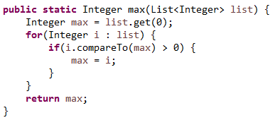
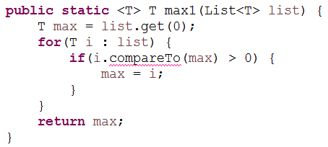
Another Generalization Example: Finding the max
Problem: Find the max value in a List.
Easy Case: First try finding the max of a list of Integers:
Try to generalize to an arbitrary type T (this first try doesn’t quite work…)
Problem: T may not be a type that has a compareTo operation – we get a compiler error

Slide 32
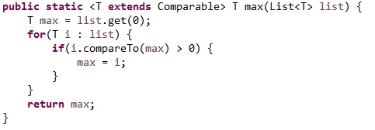
Solution: It is possible to use the "extends" keyword to force the type T to be an implementer of the Comparable interface. This produces a bounded type variable T extends Comparable
Demo: lesson11.lecture.generics.genericprogrammingmax

Slide 33
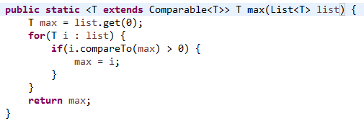
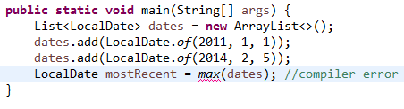
Generalizing Even Further
The Comparable interface is also generic. For a given class C, implementing the Comparable interface implies that comparisons will be done between a current instance of C and another instance; the other instance type is the type argument to use with Comparable. For example, String implements Comparable<String>. This leads to:
This version of max can be used for most kinds of Lists, but there are exceptions. Example:

Slide 34
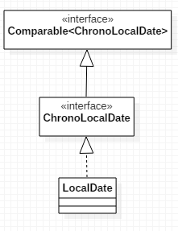
Finding the max (cont.)
The Problem: LocalDate does not implement Comparable<LocalDate>. Instead, the relationship to Comparable is the following:
What is needed is a max function that accepts types T that implement not just Comparable<T>, but even Comparable<S> for any supertype S of T.
Here, T is LocalDate. We want max to accept a list of LocalDates using a Comparable<S> for any supertype S of LocalDate.
The solution lies in the use of bounded wildcards.
LocalDate implements Comparable<ChronoLocalDate>

Slide 35
Lesson Outline
Introduction to generics
Generic methods
Wildcards
Understanding Common Generic Signatures
Generic programming with generics

Slide 36
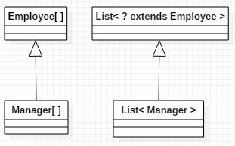
The ? extends Bounded Wildcard
The fact that generic subtyping is not covariant – as in the example that List<Manager> is not a subtype of List<Employee> – is inconvenient and unintuitive. This is remedied to a large extent with the extends bounded wildcard.

Slide 37
The ? extends Bounded Wildcard (cont.)
The ? is a wildcard and the “bound” in List<? extends Employee> is the class Employee. List<? extends Employee> is called a parametrized type with a bound.
For any subclass C of Employee, List<C> is a subclass of List<? extends Employee>.
So, even though the following gives a compiler error:
List<Manager> list1 = //… populate with managers List<Employee> list2 = list1; //compiler error
the following does work:
List<Manager> list1 = //… populate with managers List<? extends Employee> list2 = list1; //compiles
(See demo lesson10.lecture.generics.extend)

Slide 38
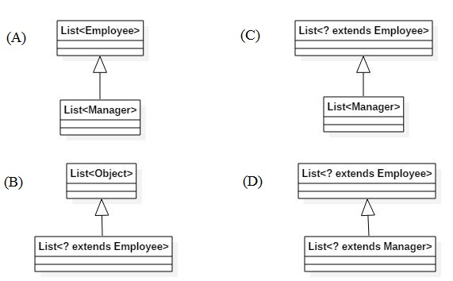
Exercise 11.3
Determine which diagrams are correct and which are not.

Slide 39
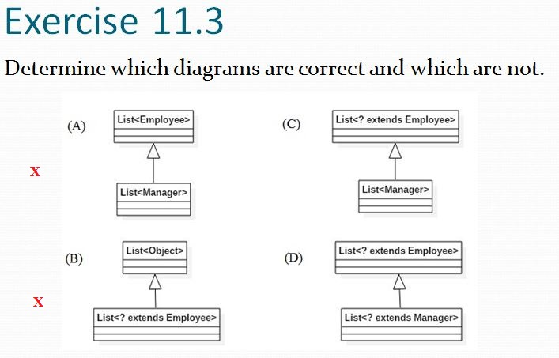

Exercise 11.3 - Solution

Slide 40
Applications of the ? extends Wildcard
The Java Collection interface has an addAll method:
interface Collection<E> { . . . public boolean addAll(Collection<? extends E> c); . . . }
The extends wildcard in the definition makes the following possible:
List<Employee> list1 = //….populate (here, E is Employee) List<Manager> list2 = //… populate list1.addAll(list2); //OK

Slide 41
Applications of the ? extends Wildcard
If the interface method had been declared like this:
interface Collection<E> { . . . public boolean addAllBad(Collection<E> c); . . . }
it would mean for example that addAllBad could accept only a Collection of Employees: List<Employee> list1 = //….populate List<Employee> list2 = //…populate list1.addAllBad(list2); //OK
BUT
List<Employee> list1 = //….populate List<Manager> list2 = //…populate list1.addAllBad(list2); //compiler error
See the demo: lesson11.lecture.generics.addall

Slide 42
Another Example Using addAll
List<Number> nums = new ArrayList<Number>();
List<Integer> ints = Arrays.asList(1, 2);
List<Double> doubles = Arrays.asList(2.78, 3.14);
nums.addAll(ints);
nums.addAll(doubles);
System.out.println(nums); //output: [1, 2, 2.78, 3.14]
Here, since Integer and Double are both subtypes of Number, it follows that List<Integer> and List<Double> are subtypes of List<? extends Number>, and addAll maybe used on nums to add elements from both ints and doubles.

Slide 43
Limitations of the extends Wildcard
When the extends wildcard is used to define a parametrized type, the type cannot be used for adding new elements.
Example:
Recall the addAll method from Collection: interface Collection<E> { . . . public boolean addAll(Collection<? extends E> c); . . . }
The following produces a compiler error:
List<Integer> ints = new ArrayList<Integer>(); ints.add(1); ints.add(2); List<? extends Number> nums = ints; nums.add(3.14); //compiler error System.out.println(ints.toString()); //output: [1, 2, 3.14] nums.add(null); //OK

Slide 44
Limitations of the extends Wildcard (cont.)
The error arises because an attempt was made to insert a value in a parametrized type with extends wildcard parameter. With the extends wildcard, values can be gotten but not inserted.
The difficulty is that adding a value to nums makes a commitment to a certain type (Double in this case), whereas nums is defined to be a List that accepts subtypes of Number, but which subtype is not determined. The value 3.14 cannot be added because it might not be the right subtype of Number.
NOTE: Although it is not possible to add to a list whose type is specified with the extends wildcard, this does not mean that such a list is read-only. It is still possible to do the following operations, available to any List: remove, removeAll, retainAll and also execute the static methods from Collections: sort, binarySearch, swap, shuffle

Slide 45
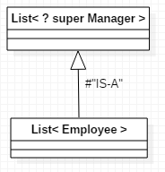
The ? super Bounded Wildcard
The type List<? super Manager> consists of objects of any supertype of the Manager class, so objects of type Employee and Object are allowed.
This diagram can be read as follows: A List<Employee> is a List whose type argument Employee is a supertype of Manager. Therefore, a List<Employee> IS-A List<? super Manager>.

Slide 46

Limitations of the super Wildcard
When the super wildcard is used to define a Collection of parametrized type, it is inconvenient to get elements from the Collection; elements can be gotten, but not typed.
Example:
However, if we try to assign a type to the return of the get method, we get a compiler error – the compiler has no way of knowing which supertype of Integer is being gotten.
Integer val = test.get(0); //compiler error Number val = test.get(0); //compiler error Comparable val = test.get(0); //compiler error Object val = test.get(0); //OK

Slide 47
The Get and Put Principle for Bounded Wildcards
The Get and Put Principle:
Use an extends wildcard when you only get values out of a structure. Use a super wildcard when you only put values into a structure. And don’t use a wildcard at all when you both get and put values.
Example-1 This method takes a collection of numbers, converts each to a double, and sums them up. The loop gets from an ? extends type of Collection.
public static double sum(Collection<? extends Number> nums) { double s = 0.0; for(Number num: nums) s += num.doubleValue(); return s; }
Since List<Integer>, List<Double> are subtypes of Collection<? extends Number>, the following are legal:
List<Integer> ints = Arrays.asList(1, 2, 3); Integer val = sum(ints); //output: 6.0
List<Double> doubles = Arrays.asList(2.78, 3.14); Double val = sum(doubles); //output 5.92

Slide 48
The Get and Put Principle for Bounded Wildcards (cont.)
Example-2 (from the Collections class)
public static <T> void copy(List<? super T> destination, List<? extends T> source) { for(int i = 0; i < source.size(); ++i) { destination.set(i, source.get(i)); } }
Note that we get from source, which is typed using extends, and we insert into destination, which is typed using super. It follows that any subtype of T may be gotten from source, and any supertype of T may be inserted into destination.
Sample usage:
List<Object> objs = Arrays.asList(2, 3.14, "four");
List<Integer> ints = Arrays.asList(5, 6);
//copy the narrow type (Integer) into the wider type (Object)
Collections.copy(objs, ints);
System.out.println(objs.toString()); //output: [5, 6, four]

Slide 49

The Get and Put Principle for Bounded Wildcards (cont.)
Example-3 (using ? super) Whenever you use the add method for a Collection, you are inserting values, and so ? super should be used.
The count method "counts" from o to n-1, adding these numbers to the input Collection ints.

Slide 50
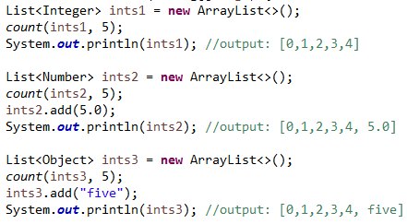
The Get and Put Principle for Bounded Wildcards (cont.)
Since super was used, the following are legal:
In the second call, ints2 is of type List<Number> which “IS-A” Collection<? super Integer> (since Number is a superclass of Integer), so the count method can be called.
In the third call, ints3 is of type List<Object> which also “IS-A” Collection<? super Integer> (since Object is a superclass of Integer), so the count method can be called here too.
Note that the add methods shown here have nothing to do with the ? super declaration – you can add a double to a List<Number> and a String to a List<Object> for the usual reasons.

Slide 51
The Get and Put Principle for Bounded Wildcards (cont.)
Example-4 Improving implementation of the max function
We saw before that this implementation of max was not general enough
We encountered a compiler error here:

Slide 52
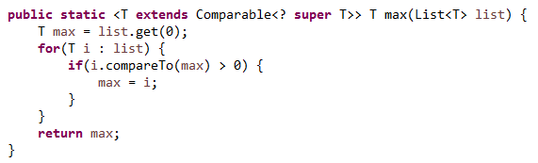
To ensure that the type T extends Comparable<S> for any supertype of T, we can use ? super
Using this version eliminates the earlier compiler error.

Slide 53
When You Need to Do Both Put and Get
Whenever you both put values into and get values out of the same structure, you should not use a wildcard.
public static double sumCount(Collection<Number> nums, int n) {
count(nms, n);
return sum(nums);
}
The collection is passed to both sum and count, so its element type must both extend Number (because of sum) and be a superclass of Integer (because of the count method). The only two classes that satisfy both requirements are Number and Integer. In this code, Number was chosen.
List<Number> nums = new ArrayList<Number>();
double sum = sumCount(nums, 5);
//sum is 10

Slide 54
Two Exceptions to the Get and Put Rule
In a Collection that uses the extends wildcard, null can always be added legally (null is the “ultimate” subtype)
List<Integer> ints = new ArrayList<>(); ints.add(1);
ints.add(2); List<? extends Number> nums = ints; nums.add(null); //OK System.out.println(nums.toString()); //output: [1, 2, null]
In a Collection that uses the super wildcard, any object of type Object can be read legally (Object is the “ultimate” supertype).
List<? super Integer> list = new ArrayList<>(); list.add(1);
list.add(2);
Object ob = list.get(0);
System.out.println(ob.toString()); //output: 1

Slide 55
Main Point 2
The Get and Put Rule describes conditions under which a parametrized type should be used only for reading elements (when using a list of type ? extends T), other conditions under which the parametrized type should be used only for inserting elements (when using a list of type ? super T), and still other conditions under which the parametrized type can do both (when no wildcard is used). The Get and Put principle brings to light the fundamental dynamics of existence: there is dynamism (corresponding to Put); there is silence (corresponding to Get) and there is wholeness, which unifies these two opposing natures (corresponding to Both).

Slide 56
Unbounded Wildcard, Wildcard Capture, Helper Methods
The wildcard ?, without the super or extends qualifier, is called the unbounded wildcard.
Collection<?> is an abbreviation for Collection<? extends Object>
Collection<?> is the supertype of all parametrized type Collections.

Slide 57

Important application of the unbounded wildcard involves wildcard capture:
Example Try to copy the 0th element of a general list to the end of the list
First Try
Compiler error arises because we are trying to add to a List whose type involves the extends wildcard.

Slide 58
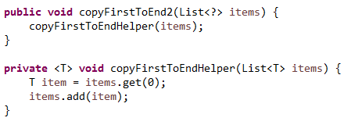
Solution: Write a helper method that captures the wildcard.
Notes:
Passing items into the helper method causes the unknown type ? to be “captured” as the type T.
In the helper method, getting and setting values is legal because we are not dealing with wildcards in that method.

Slide 59
Exercise 11.4
The following code attempts to reverse the elements of a generic list, but the code does not compile. Fix the code by creating a helper method that captures the wildcard. Startup code is in the lesson11.exercise_4 package of the InClassExercises project. Test your code with the main method that has been provided.
public static void reverse(List<?> list) { List<Object> tmp = new ArrayList<Object>(list); for (int i = 0; i < list.size(); i++) {
list.set(i, tmp.get(list.size()-i-1));
}
}

Slide 60
Lesson Outline
Introduction to generics
Generic methods
Wildcards
Understanding Common Generic Signatures
Generic programming with generics

Slide 61
Understanding Common Generic Signatures: forEach
The new default forEach method in Iterable has the following declaration:
void forEach(Consumer<? super T> action)
Here, the type T signifies the type of the collection elements under consideration. The bounded wildcard indicates that forEach can accept a Consumer type that is a supertype of the particular Collection type T.

Slide 62
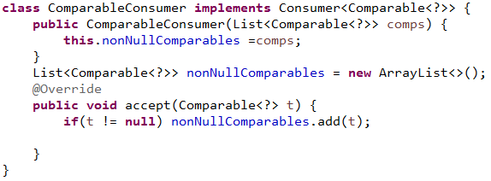
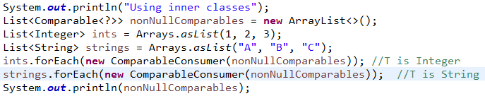
forEach Example
void forEach(Consumer<? super T> action)

Slide 63
Understanding Common Generic Signatures: forEach (cont.)
Scenario: I want to arrange integers, strings, and possibly other types of orderable objects into a single list, and arrange them in some order. So we create a List<Comparable> and add a list ints of integers to it, and another list strings of Strings to it, using the forEach method. This is possible because forEach accepts supertypes of the base type. For the ints list, the starting type is Integer; for the strings list, it is String.
Demo: lesson11.lecture.generics.signatures
In more detail: When we add ints to my list of Comparables, using forEach, we use a Consumer<Comparable> (which IS-A Consumer<? super Integer>) as an argument to forEach as it traverses a List<Integer>. In the second use of forEach, we again use a Consumer<Comparable> (which IS-A Consumer<? super String >) as an argument to forEach as it traverses a List<String>.

Slide 64
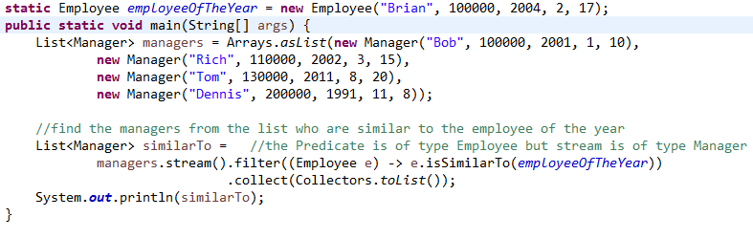
Understanding Common Generic Signatures: filter
The filter method on a Stream<T> has this signature:
Stream<T> filter(Predicate<? super T> predicate)
This means that tests that are made on the elements of the Stream can be based on relationships in a supertype of T. Here is an example:

Slide 65
Exercise 11.5
Re-implement the Predicate that is used in the filter method for this code by creating a nested class MyPredicate. Startup code is in the lesson11.exercise_5 package of the InClassExercises project.

Slide 66
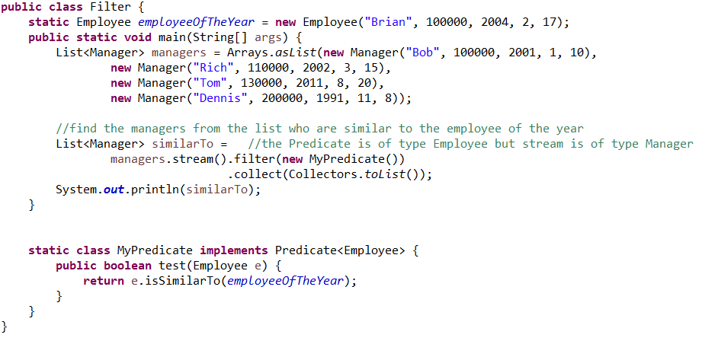
Solution

Slide 67
Understanding Common Generic Signatures: map
The map operation on Stream<T> has the following signature.
Stream<R> map(Function<? super T,? extends R> mapper)
This means that the type the map is transforming can be a supertype of the type of the list or collection that is being traversed, and that the type the map sends to can be a subtype of the expected return type.

Slide 68
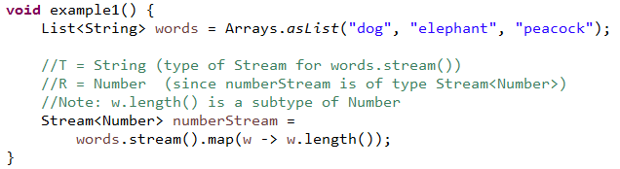
Map: Example 1
Stream<R> map(Function<? super T,? extends R> mapper)

Slide 69
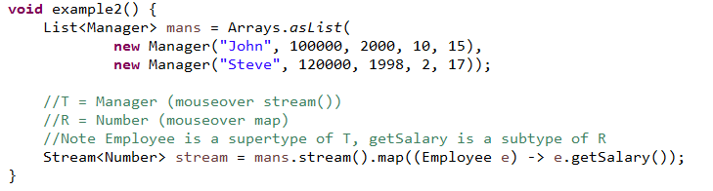
Map: Example 2
Stream<R> map(Function<? super T,? extends R> mapper)

Slide 70
Lesson Outline
Introduction to generics
Generic methods
Wildcards
Understanding Common Generic Signatures
Generic programming with generics

Slide 71
Generic Programming Using Generics
Generic programming is the technique of implementing a procedure so that it can accommodate the broadest possible range of inputs.
For instance, we have considered several implementations of a max function. The goal of generic programming in this case is to provide the most general possible max implementation.
See demos lecture.generics.max.BoundedTypeVariable and lecture.generics.max.BoundedTypeVariable2 for a development of examples leading to the most general possible version.

Slide 72
Connecting the Parts of Knowledge With the Wholeness of Knowledge Generic Programming Using Java’s Generic Methods
Using the raw Lists of pre-Java 1.5, one can accomplish the generic programming task of swapping two elements in an arbitrary list using the signature void swap(List, int pos1, int pos2). Using this swap method requires the programmer to recall the component types of the List, and there are no type checks by the compiler.
Using generic Lists of Java 1.5 and the technique of wildcard capture, it is possible to swap elements of an arbitrary List with compiler support for type-checking, using the following signature: <T> void swap(List<?> list, int pos1, int pos2)
Transcendental Consciousness is the universal value of the field of consciousness present at every point in creation.
Impulses Within the Transcendental Field. The presence of the transcendental level of consciousness within every point of existence makes individual expressions in the manifest field as rich, unique, and diversified as possible.
Wholeness Moving Within Itself. In Unity Consciousness, life is appreciated in the fullest possible way because the source of both unity and diversity have become a living reality.

